Slide 1
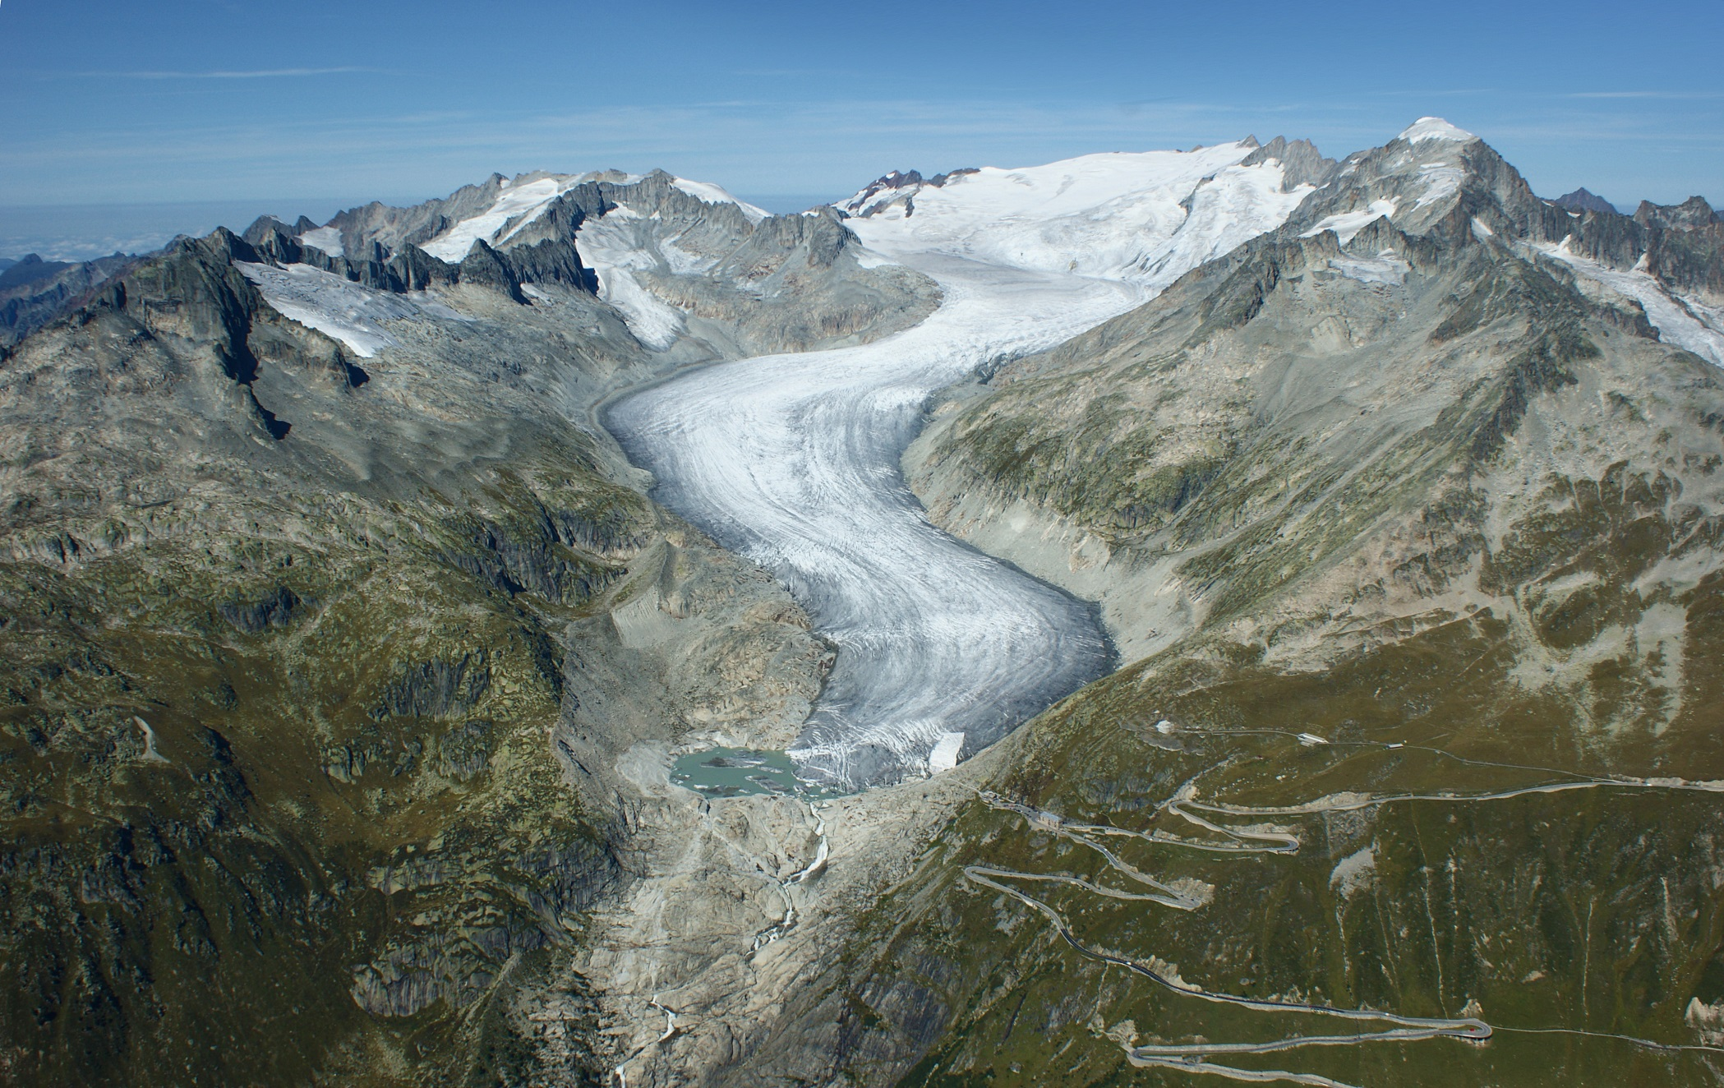
Rhone Glacier
Recession Analysis
The Leopards:
Samantha Krawczyk
Georgios Anastasiou

Slide 2
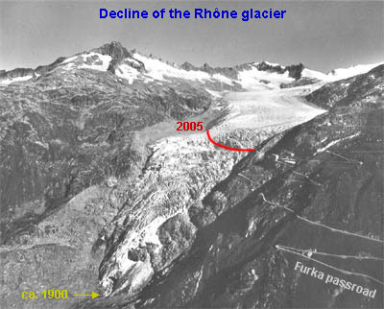
Objective
Reproduce studies showing Glacier recession
Compare annual outline and area changes

Slide 3
datasets
Landsat 5 images were used for the methodology
10 images
Only 6 used in final analysis
Pre-processed to SR
GLIMS shapefiles, for the validation of the method
Global Land Ice Measurements from Space
Polygon outlines of glaciers

Slide 4
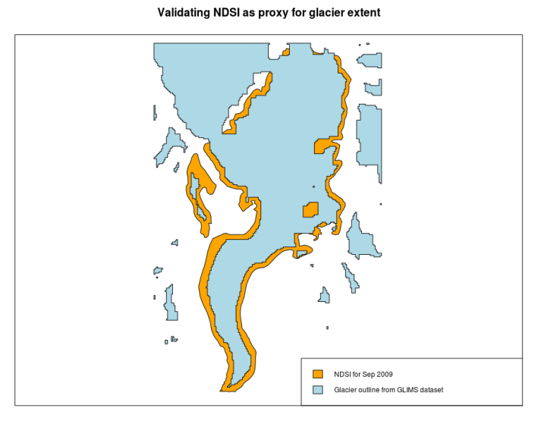
Method
ANALYSIS
Detect glacier
Proper methods require many steps
Used NDSI as proxy
(snow assumed to be glacier as looked at summer months, validated using GLIMS)
Compare over time
1984 to 2010
Asses magnitude of change

Slide 5
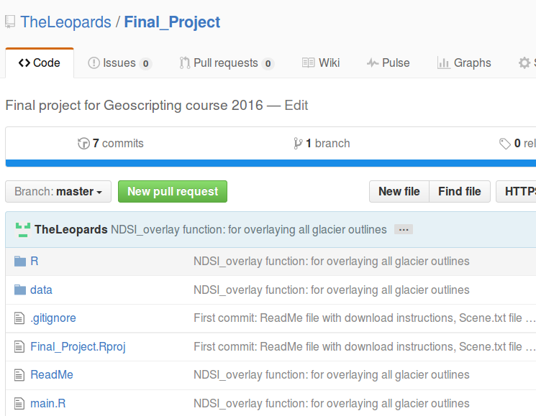
Method
SCRIPTING
Structure
main.R with variables and function calls
Function script in separate files:
Image selection
Cloud & water mask
Calculate NDSI
Plot glacier areas
Plot glacier outlines
Validate NDSI method

Slide 6
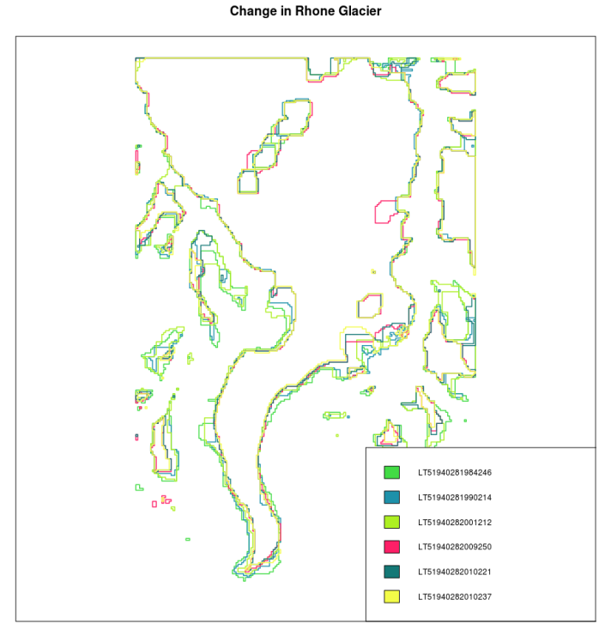
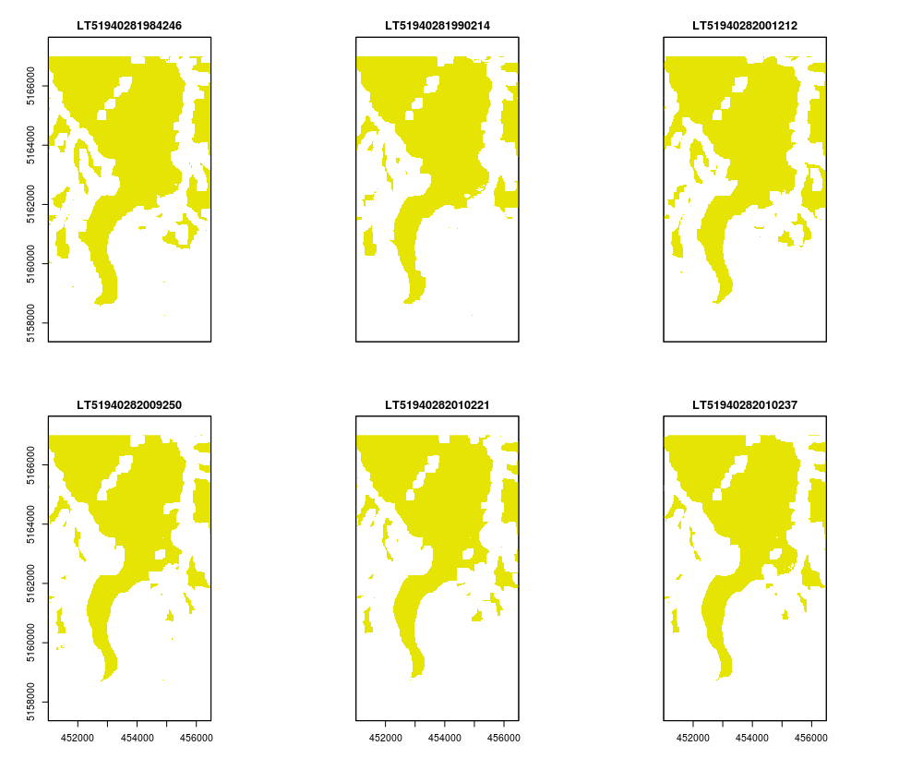
Results

Slide 7
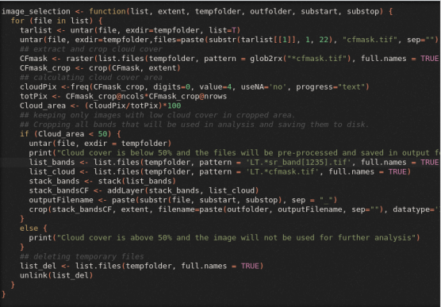
Discussion
CHALLENGES
Identifying the glacier
A lot of clouds around glacier
Random colour assignment in function
To work for n number of datasets but lose control over colour choice
Limited space & big datasets
Untar only required files , crop and process asap, delete the rest

Slide 8
Discussion
IMPROVEMENTS
Create a sieve to reduce noise around glacier
Crop glacier using buffer around GLIMS polygon
Higher spatial resolution images
Better methodology for detecting ice

Slide 9
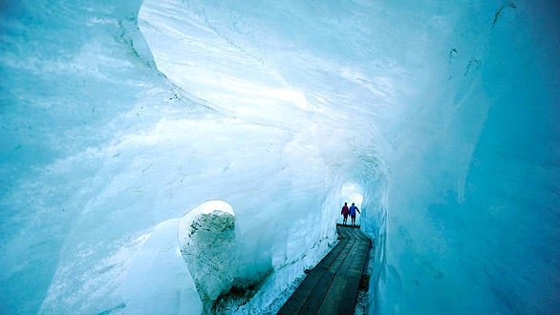
Questions?

